Slide 1

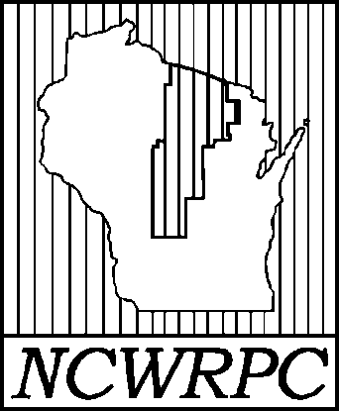

Elroy & Royall
Safe Routes to School (SRTS)

Slide 2
Today’s Agenda
Introductions
Safe Routes to School (SRTS) intro.
Review Student Tally & Parent Survey data
Info request & Schedule Walk Audit

Slide 3
SRTS Planning Timeline
October 2023 – NCWRPC applied for SRTS Planning Grant
(No cost to Elroy or District.)
July 2024 – Planning Grant Awarded.
May 2025 – Parent Surveys & Student Tallies administered.
Fall 2026 – First SRTS Task Force mtg.
Fall 2026 – Draft SRTS Plan developed & reviewed.
Winter 2026-2027 – SRTS Plan adopted. Implementation begins.

Slide 4
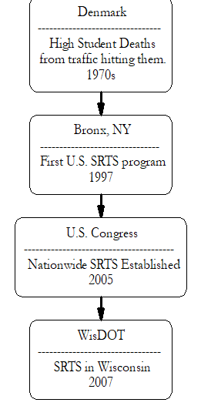
What is Safe Routes to School?
Safe Routes to School (SRTS) is an international movement and a federal program to make it safe, convenient, and fun for children, including those with disabilities, to bicycle and walk to school.
When routes are safe, walking or biking to and from school is an easy way to get the regular physical activity children need for good health.
Safe Routes to School initiatives also help ease traffic jams and air pollution, unite neighborhoods, and contribute to students’ readiness to learn in school.
Notes:
Message:
I’m here today to talk about the benefits of walking and bicycling for children, what’s getting in the way and how SRTS programs can help. Let’s begin by framing the issue:
A major decrease in the number of children who walk and bicycle to school has occurred over the last generation or so.
This decline has resulted in unintended and far-reaching consequences for both our children’s lives and our own.
Safe Routes to School programs empower communities to make walking and bicycling to school a safer, more popular way to get to school.
Let’s explore these areas in more detail.
Image:
Christa McAuliffe Elementary School, Lenexa, KS, provided by Mike Cynecki.

Slide 5
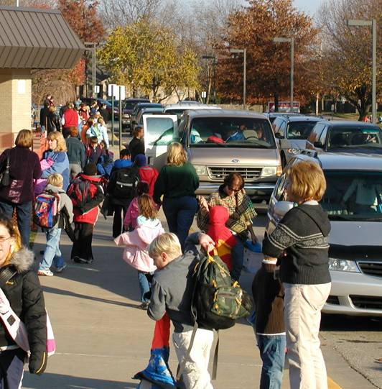
Why Safe Routes to School?
DECLINE in walking and bicycling to school
INCREASE in health consequences in children and adolescents
PART OF THE SOLUTION:
SRTS programs & infrastructure
#1
#2
#3
Notes:
Message:
I’m here today to talk about the benefits of walking and bicycling for children, what’s getting in the way and how SRTS programs can help. Let’s begin by framing the issue:
A major decrease in the number of children who walk and bicycle to school has occurred over the last generation or so.
This decline has resulted in unintended and far-reaching consequences for both our children’s lives and our own.
Safe Routes to School programs empower communities to make walking and bicycling to school a safer, more popular way to get to school.
Let’s explore these areas in more detail.
Image:
Christa McAuliffe Elementary School, Lenexa, KS, provided by Mike Cynecki.

Slide 6
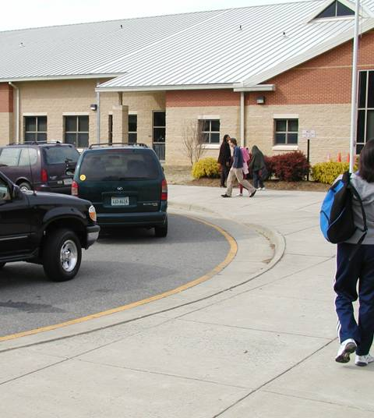
Fewer kids are biking and walking.
More parents are driving.
#1
42% walked
16% walked*
10% walked or biked**
1969
2001
2014
*CDC, 2005
** CDC, 2016
Notes:
Message:
Today fewer children are walking and biking and more parents are driving.
Only a generation ago, children routinely traveled around their neighborhoods either on foot or on bike. Walking and bicycling were common ways to get to school.
Note to presenter:
Optional: Ask all of the adults in the room who walked or bicycled regularly to school to raise their hands.
Now ask how many have children in their lives (sons, daughters, grandchildren, neighbors) currently walk or bike to school. There’s likely a large difference.
Image:
Linwood Holton Elementary School, Richmond, VA, provided by Mike Cynecki.

Slide 7
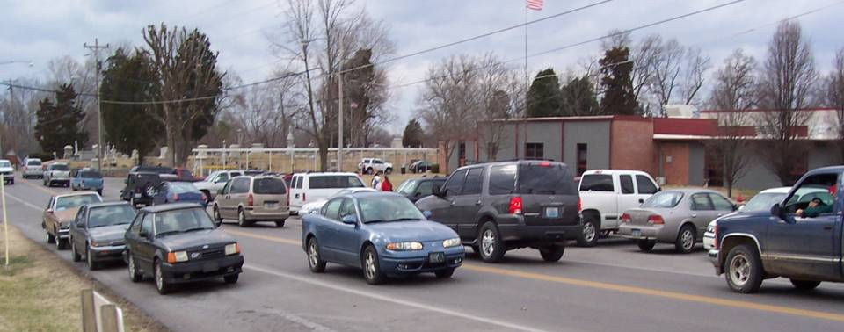
What caused the shift?
#1
Notes:
Message:
Each school has specific issues, so a Parent Survey is the first step in identifying why parents are not allowing walking or biking to school.
Let’s dig a little deeper to discover the underlying reasons for this shift in transportation habits.
Image:
Second Street School, Frankfort, Kentucky, provided by Mike Cynecki.

Slide 8
Most common barriers to walking and bicycling to school:
#1
Nationally…
Long distances 62%
Traffic danger 30%
Adverse weather 19%
Fear of crime danger 12%
Sum of percentages is more than 100% because respondents could identify more than one barrier. (CDC, 2005)
Notes:
Message:
These are common barriers nationally, and NCWRPC notes that these barriers are common within NCWRPC’s 10-county region too. These are mainly solvable barriers through SRTS analysis.
* U.S. Centers for Disease Control and Prevention. Barriers to Children Walking to or from School United States 2004, Morbidity and Mortality Weekly Report September 30, 2005. Available: www.cdc.gov/mmwr/preview/mmwrhtml/mm5438a2.htm. Accessed: December 28, 2005.
Note to presenter: Survey respondents could identify more than one barrier so the sum of the percentages is more than 100%.

Slide 9
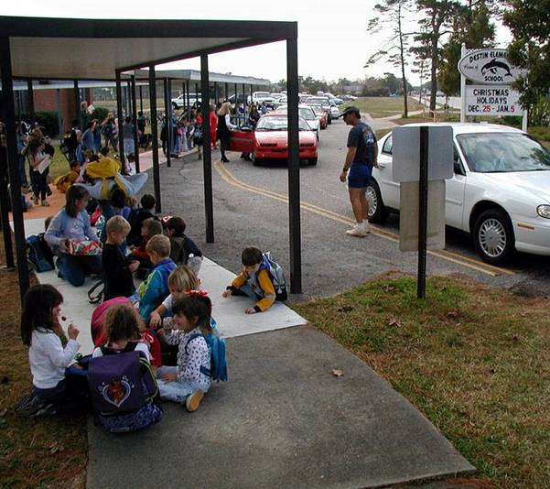
It’s not just distance.
#1
Students who live within 1 mile and walk or bike:
1969: 87%
2001: 63%
(CDC, 2005)
2017: 40%
(2017 NHTS)
Notes:
Message:
Even when children live within one mile of school, fewer are walking and bicycling than in the past.* This SRTS Plan reviews why kids are not walking or biking within 1-mile of school – an easy distance for many children.
*U.S. Centers for Disease Control and Prevention. Kids Walk-to-School: Then and Now—Barrier and Solutions. Available: http://www.cdc.gov/nccdphp/dnpa/kidswalk/then_and_now.htm Accessed: January 17, 2006.
Image:
Destin Elementary School, Destin, FL, provided by Dan Burden, available from PBIC Image Library.

Slide 10
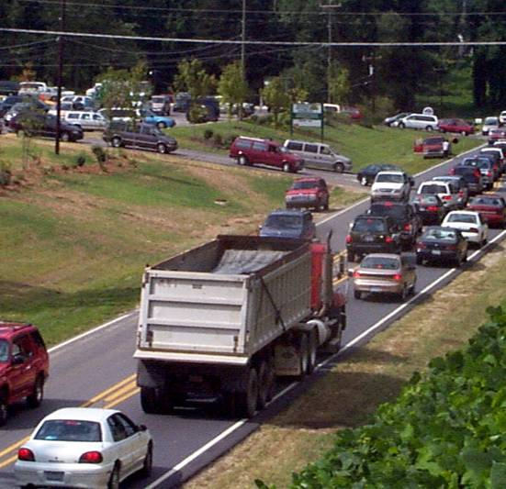
Traffic danger
Amount of traffic &
Speed of traffic
=
#1
Parents driving children to school:
20%-25%
of morning traffic around schools, and
10%-14%
of vehicle trips during morning rush hour are for school travel.
(NHTSA 2003, & U.S. Department of Transportation, 2015)
Notes:
Message:
Morning and afternoon drop-off often looks like this at many schools.
Reducing traffic danger is key to increasing walking and biking to school rates.
Image:
Unknown location, provided by Dan Burden.

Slide 11
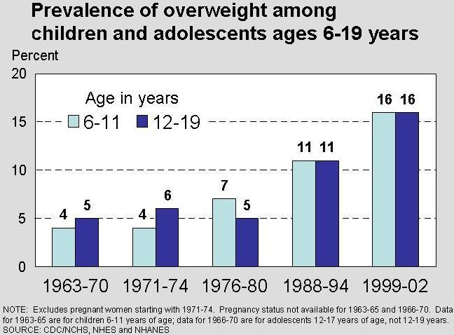
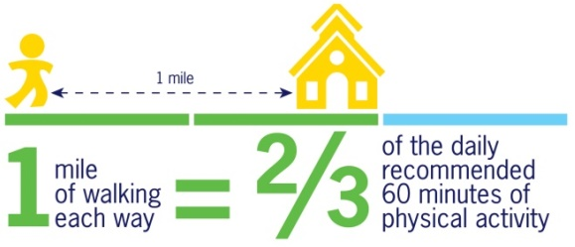
Unintended Consequence:
Physical inactivity
#2
21
18
2015-16
(National Center for Health Statistics, National Health and Nutrition Examination Surveys)
Notes:
Message:
Less active children are more likely to be overweight.*
So while kids are getting less activity, the proportion of overweight children has been increasing dramatically.
The percentages of 6-11 and 12-19 year-old kids considered severely overweight have tripled in the last 30 years.**
Diet is certainly a factor as well, and many schools have adopted wellness policies that incorporate Safe Routes to School and healthy eating campaigns.
Note: These data show the percentage of American children in two age groups whose weight is higher than the 95th percentile of the recommended weight for their height. The medical community doesn’t yet define “obesity” for children (such as a BMI over 30, as it does for adults).
*American Academy of Pediatrics (2003). “Policy statement on the prevention of pediatric overweight and obesity.” http://aappolicy.aappublications.org/cgi/content/full/pediatrics;112/2/424
**Hedley AA, Ogden CL, Johnson CL, Carroll MD, Curtin LR, & Flegal KM. (2004). Prevalence of overweight and obesity among US children, adolescents, and adults, 1999-2002. JAMA, 291(23):2847-50.
Image:
National Center for Health Statistics Image source: U.S. Centers for Disease Control and Prevention. National Center for Health Statistics. Prevalence of Overweight Among Children and Adolescents: United States, 1999-2002. Available: http://www.cdc.gov/nchs/products/pubs/pubd/hestats/overwght99.htm#Table%201. Accessed: January 31, 2006.

Slide 12
Overweight children have an increased risk of…
#2
Type 2 Diabetes
Low self esteem
Decreased physical functioning
Obesity in adulthood
Many other negative emotional & physical effects
(Institute of Medicine, 2005)
Notes:
Message:
Obese children suffer immediate social, emotional and physical health effects and are more likely to be obese adults.*
*Institute of Medicine (2005). “Preventing childhood obesity: Health in the balance.” Accessed on January 3, 2005 at http://www.nap.edu/books/0309091969/html/.

Slide 13
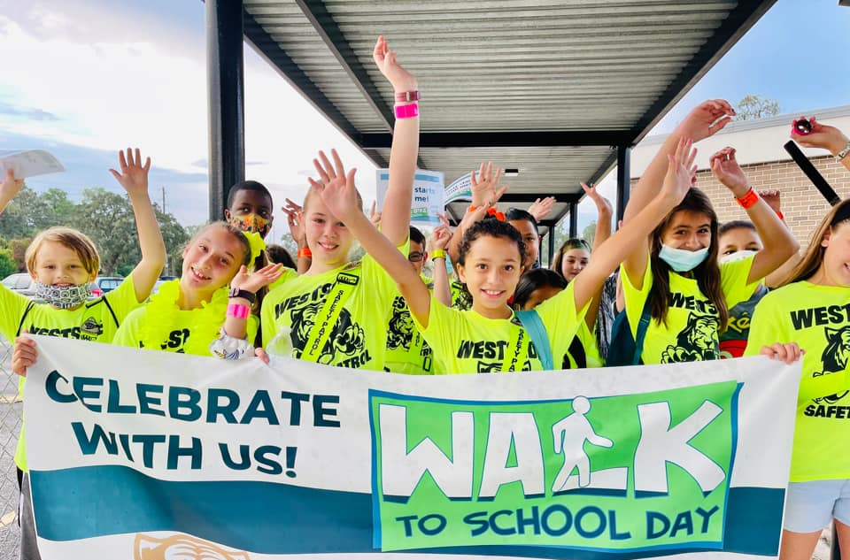
Safe Routes to School programs are part of the solution…
#3
It’s FUN!
Improved academic performance
…to improve walking and bicycling conditions
…to increase physical activity
Reduce congestion around schools
Reducing student transportation costs
(personal vehicle use and busing)
Dallas, TX
Notes:
Message:
Safe Routes to School programs can be part of the solution to making and walking and biking safer, and thereby increase physical activity among children.
Image:
Mitchell Elementary, Dallas, TX, provided through www.iwalktoschool.org.

Slide 14





Elements of SRTS programs:
Notes:
Summary:
The National Center for Safe Routes to School web site has tools to help communities plan and implement SRTS programs.
Thank you.
Image:
www.saferoutesinfo.org

Slide 15
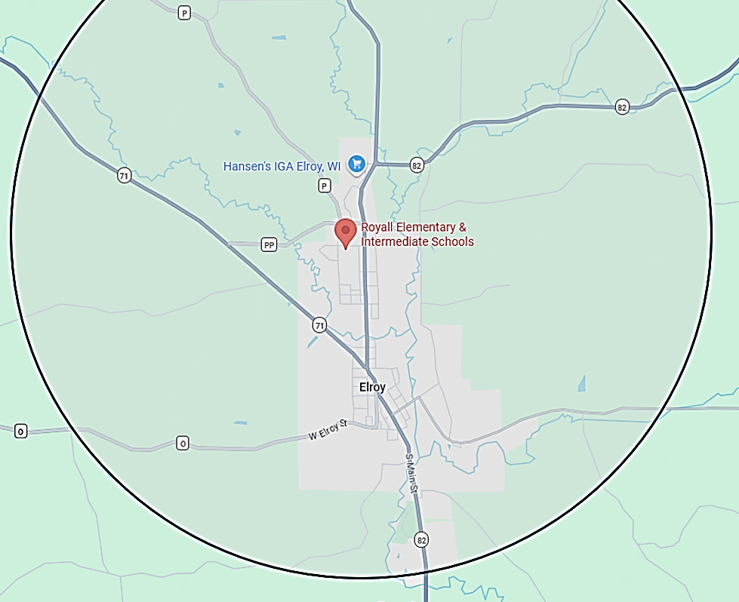
2-Mile Radius
WisDOT projects apply within 2-mile buffer.
State funding for busing exists beyond buffer.
Notes:
Summary:
The National Center for Safe Routes to School web site has tools to help communities plan and implement SRTS programs.
Thank you.
Image:
www.saferoutesinfo.org

Slide 16
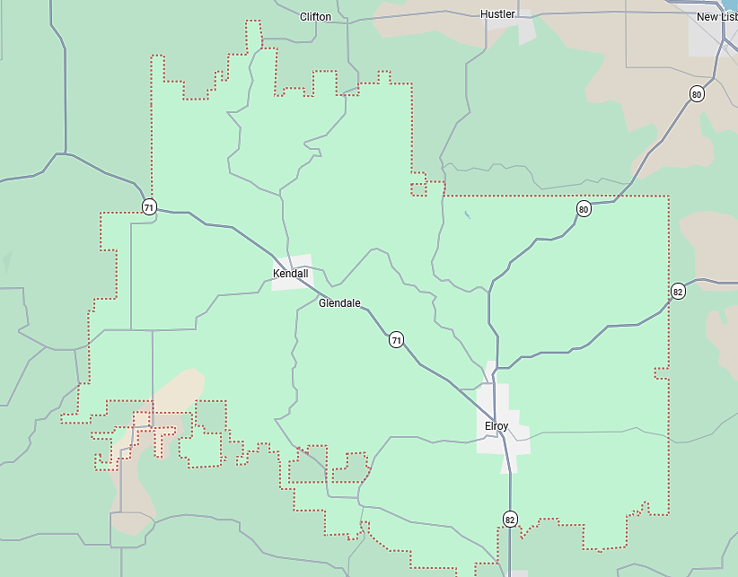
Royall SRTS Schools
Royall Elementary & Intermediate School (PK-6)
Royall Middle & High School (7-12)
Kendall
Elroy
Notes:
Summary:
The National Center for Safe Routes to School web site has tools to help communities plan and implement SRTS programs.
Thank you.
Image:
www.saferoutesinfo.org

Slide 17
Survey Says…
Royall SRTS Schools
Student Tally results
Parent Survey results
Notes:
Summary:
The National Center for Safe Routes to School web site has tools to help communities plan and implement SRTS programs.
Thank you.
Image:
www.saferoutesinfo.org

Slide 18
Royall PK-6 Student Tallies – May 2025

Slide 19
Royall 7-12 Student Tallies – May 2025

Slide 20
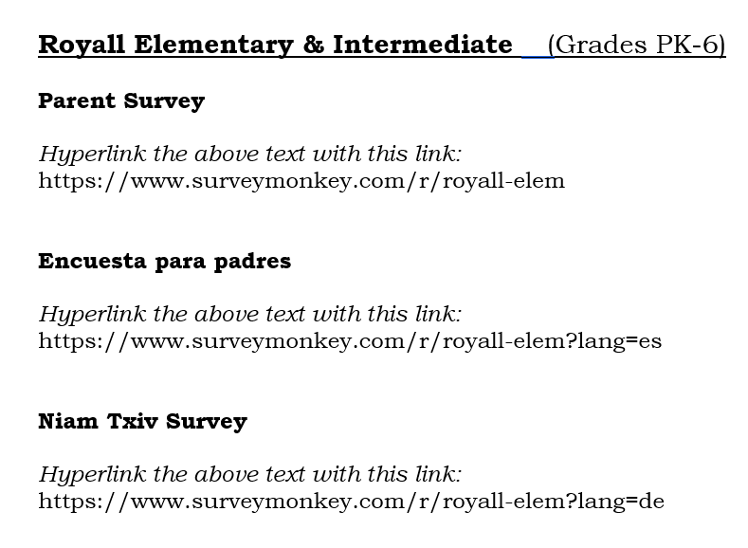
Parent Surveys – May 2025
A survey of all parents occurred in May 2025.
How did your child get to school?
What change is needed before you allow child to walk to school?
Notes:
Summary:
The National Center for Safe Routes to School web site has tools to help communities plan and implement SRTS programs.
Thank you.
Image:
www.saferoutesinfo.org

Slide 21
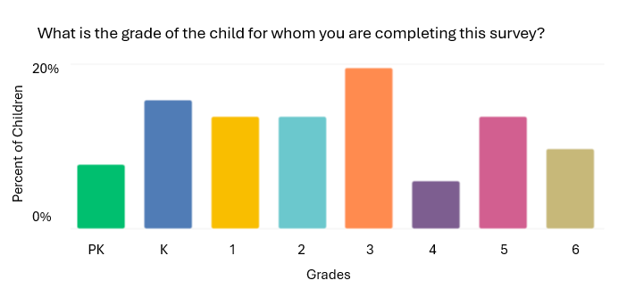
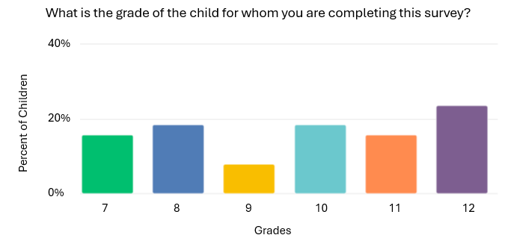
Overall Parent Surveys…
Royall PK-6
51 Parent Surveys
Royall 7-11
38 Parent Surveys
Notes:
Summary:
The National Center for Safe Routes to School web site has tools to help communities plan and implement SRTS programs.
Thank you.
Image:
www.saferoutesinfo.org

Slide 22
Royall PK-6 Parent Surveys…
Notes:
Summary:
The National Center for Safe Routes to School web site has tools to help communities plan and implement SRTS programs.
Thank you.
Image:
www.saferoutesinfo.org

Slide 23
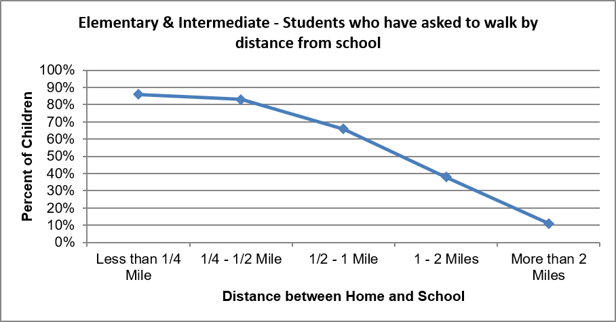
Royall PK-6 kids asked to walk or bike:
Notes:
Summary:
The National Center for Safe Routes to School web site has tools to help communities plan and implement SRTS programs.
Thank you.
Image:
www.saferoutesinfo.org

Slide 24
Royall 7-12 Parent Surveys…
Notes:
Summary:
The National Center for Safe Routes to School web site has tools to help communities plan and implement SRTS programs.
Thank you.
Image:
www.saferoutesinfo.org

Slide 25
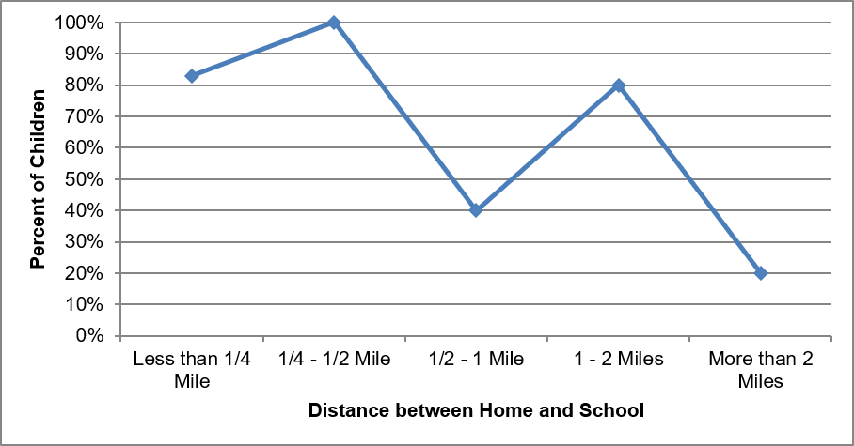
Royall 7-12 kids asked to walk or bike:
Notes:
Summary:
The National Center for Safe Routes to School web site has tools to help communities plan and implement SRTS programs.
Thank you.
Image:
www.saferoutesinfo.org

Slide 26
Royall PK-6 parent’s most common barriers to allowing walking/bicycling to school:
#1 Distance (66%)
#2 Safety of intersections (39%)
#4 Speed of traffic along route (34%)
#5 Sidewalks or pathways (25%)
#3 Amount of traffic along route (39%)

Slide 27
Royall 7-12 parent’s most common barriers to allowing walking/bicycling to school:
#1 Distance (66%)
#2 Safety of intersections & crossings (39%)
#4 Speed of traffic along route (34%)
#5 Sidewalks or paths (25%)
#3 Amount of traffic along route (39%)

Slide 28
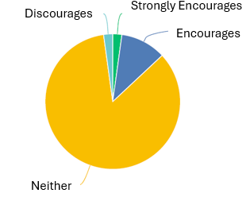
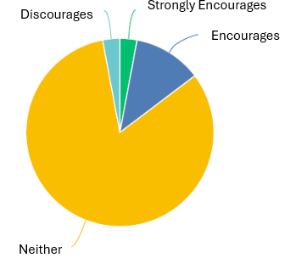
Royall parents…
How much does your child’s school encourage or discourage walking and biking to/from school?
Royall Elementary Grades Pk-6
Royall Middle & High School Grades 7-12

Slide 29
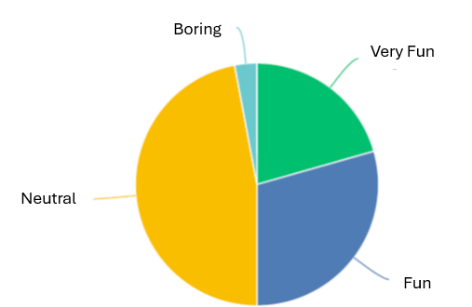
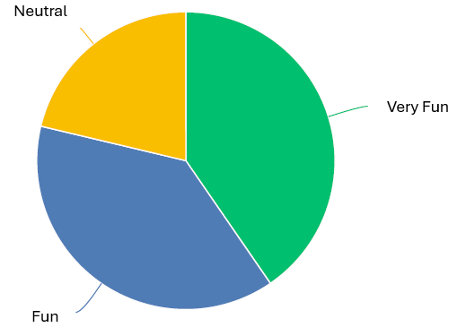
Royall parents…
How much fun is walking and biking to/from school for your child?
Royall Elementary Grades Pk-6
Royall Middle & High School Grades 7-12

Slide 30
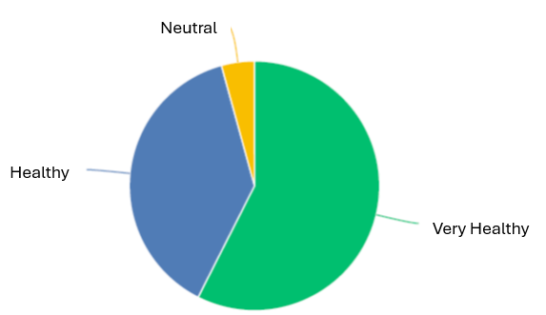
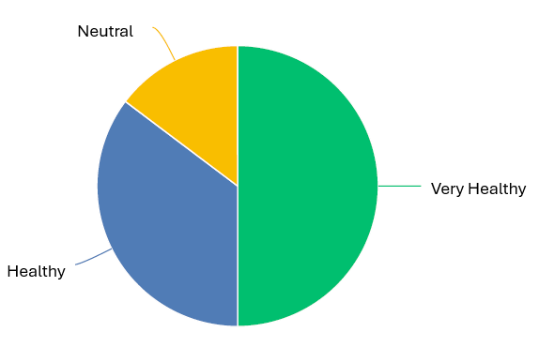
Royall parents…
How healthy is walking and biking to/from school for your child?
Royall Elementary Grades Pk-6
Royall Middle & High School Grades 7-12

Slide 31
Maps…
Royall SRTS Schools
Site Assessment map
Transportation map
School Routes map

Slide 32
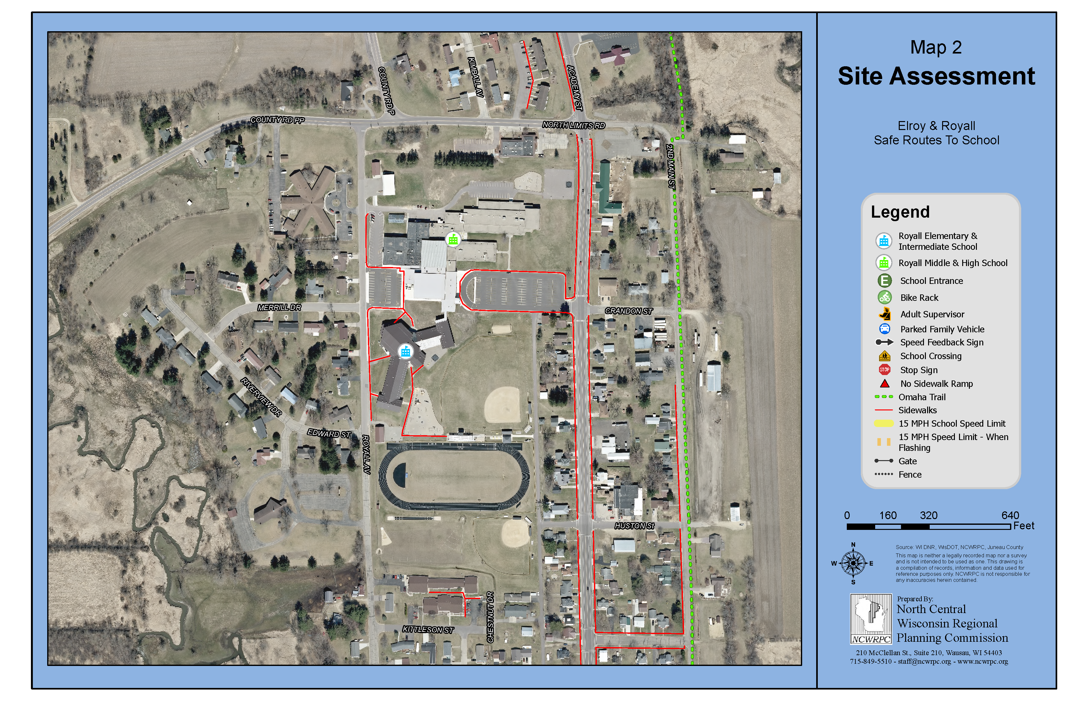
Site Assessment maps…
Walk Audit notes go on this map.

Slide 33
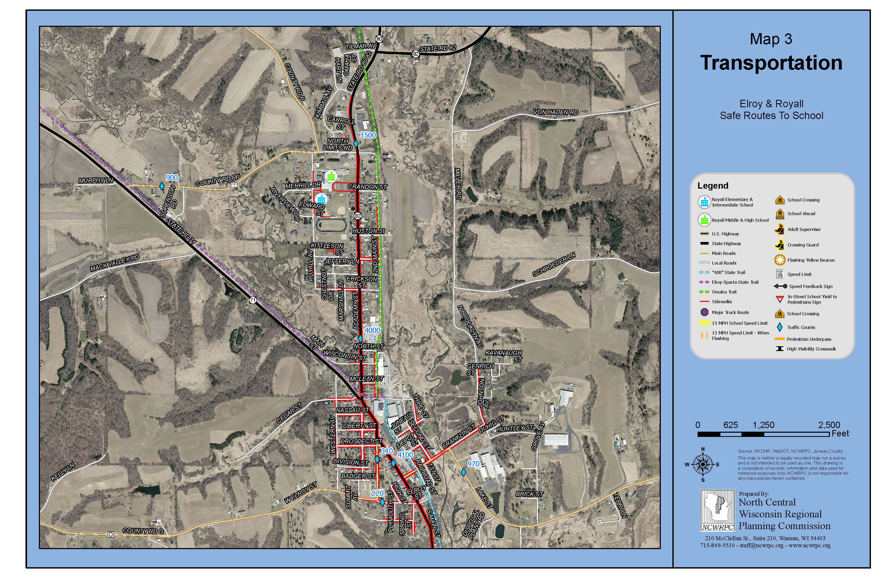
Transportation maps…

Slide 34
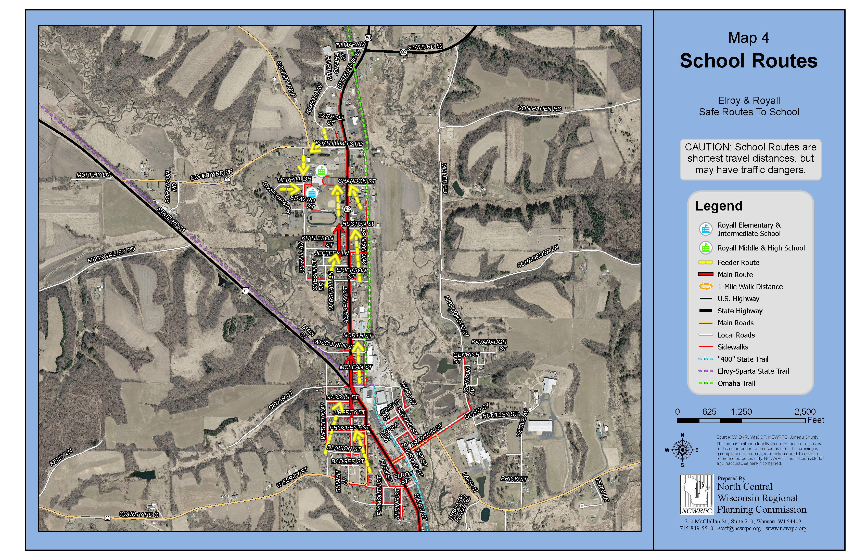
School Routes maps…

Slide 35
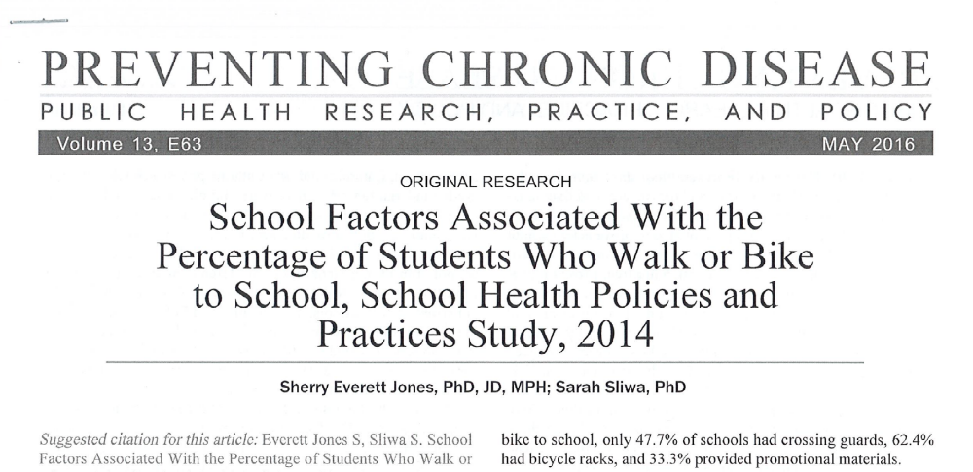
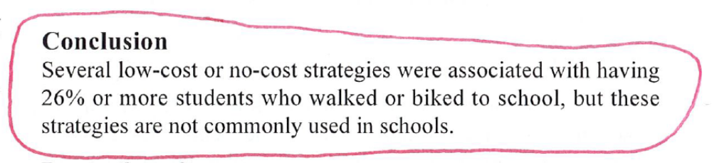
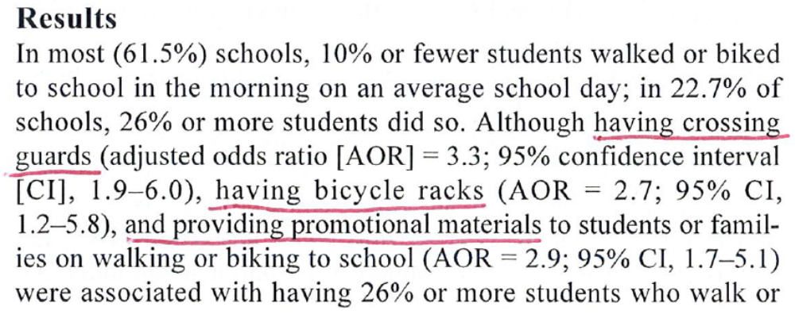
Is SRTS it really difficult???

Slide 36
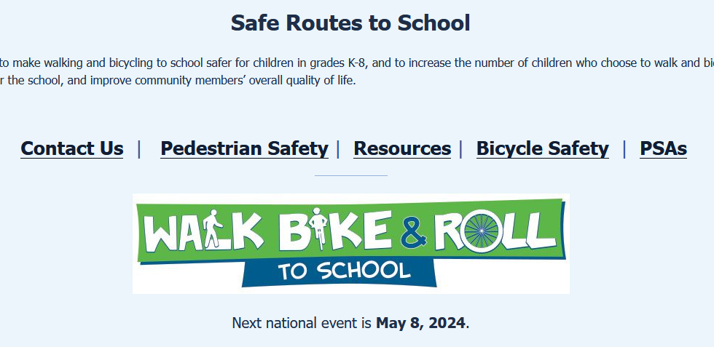
North Central WI Regional Planning Commission
  Fred Heider, AICP
ncwrpc.org/elroy-royall-srts-2027/

